Slide 1

TELECOM CUSTOMER CHURN
ANALYSIS
N a m e : Bishal Bikash Mohanty
E m a i l : bikashbishalmohanty@gmail.com

Slide 2

Agenda
This presentation covers the complete telecom churn analysis workflow, including the project overview, dataset details, business problem, data cleaning steps, key insights, customer behavior patterns, churn factors, dashboard walkthrough, and final recommendations.

Slide 3
Project Overview
Telecom companies face high customer churn due to increasing competition and service dissatisfaction. This project analyzes customer data to identify churn drivers, highlight risky customer segments, and provide data-driven insights to support retention strategies.

Slide 4

Business Problem
Customer churn directly impacts revenue and long-term profitability. Understanding the reasons behind churn enables companies to take preventive action. The challenge is to detect early signs of dissatisfaction and implement retention-focused strategies.

Slide 5

About the Dataset
The dataset contains customer demographics, subscription details, billing information, and churn status. It includes variables such as gender, senior citizen, tenure, contract type, payment method, internet services, monthly charges, total charges, and whether the customer has churned.

Slide 6
Key Business Questions
This project aims to answer several important questions:
What factors contribute most to churn?
Which customer segments are at high risk?
How do contract type, tenure, and billing affect churn?
Do services like fiber optic or online security impact churn?
What retention strategies can reduce churn?
What is the percentage of male & female customers by contract
in customer and churner profile?
What is the percentage of senior & non-senior citizens for entire customers and churner profiles?
What is gender distribution and how is gender related to churn?
What is the percentage of contracts by gender in entire customers and churner profiles?
What is the distribution of the contract by monthly charges and
total charges?
What is the distribution of tenure bins by monthly charges and total charges?

Slide 7
Data Cleaning Steps
Data cleaning involved handling null values in monthly charges and total charges, converting data types, creating tenure groups, filtering churned customers, and preparing the dataset for analysis. These steps ensured accurate and meaningful insights.
What is the percentage of customers with department and partner in customers and churner profile.?
What is the chance of churn based on payment method?
What is the percentage of internet services by gender?
What is the percentage of customers who deposit online security?
What is the percentage of multiple lines connected by gender?
What is the chance of churn based on the bil delivery method?
What is the percentage of technical support by gender?
What is the chance of churn based on dependents?
What is the chance of churn based on device protection?

Slide 8
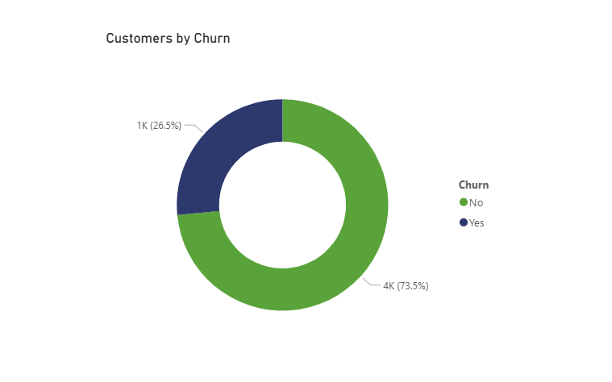
Overall Churn Summary
The dashboard shows that out of 5000 customers, 1325 have churned, resulting in a churn rate of 26.5%. This indicates that more than one-fourth of the total customers have left the service, which is a serious concern for the business.

Slide 9
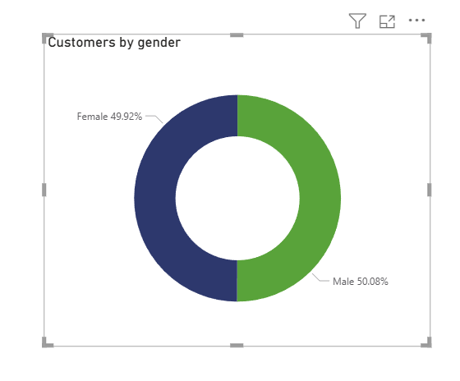
The customer base is almost evenly split between male and female users. However, churn distribution is slightly higher among females. This suggests that gender has a mild impact, but it still contributes to overall churn behavior.
Customers by Gender

Slide 10
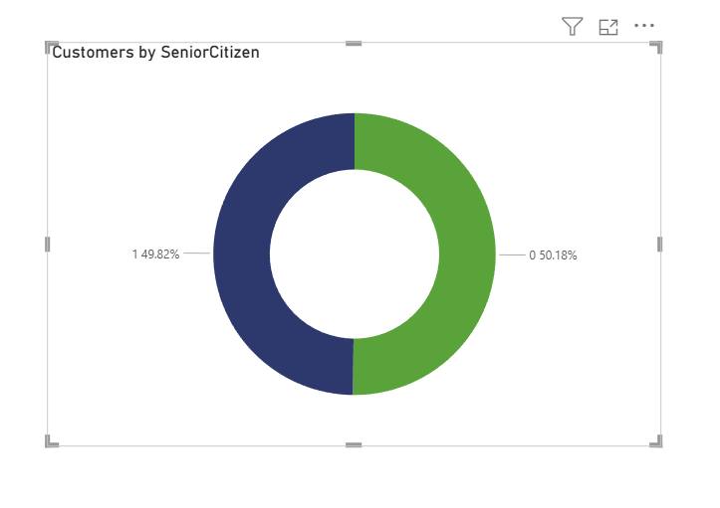
Senior citizens represent a significant portion of the customer base. The churn rate among senior citizens is noticeably higher, possibly due to higher monthly charges or lack of technical support. Older customers require more service reliability and assistance.
In
Senior Citizen Distribution

Slide 11
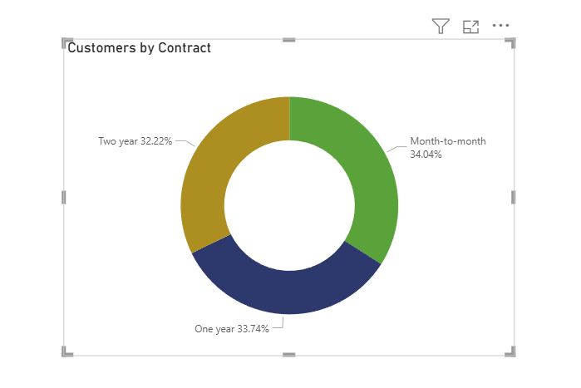
Month-to-month contracts make up the largest portion of the dataset. These customers show the highest churn rate because short-term contracts provide flexibility to switch providers easily. Long-term contracts show more customer loyalty.
Customers by Contract Type

Slide 12
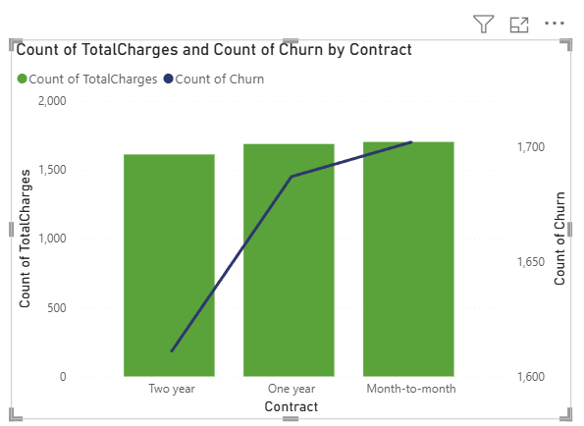
Customers with lower total charges tend to churn more. This indicates that new or short-tenure customers are more likely to leave early, possibly due to dissatisfaction with early service experiences. Long-term users show more commitment.
Total Charges Analysis

Slide 13
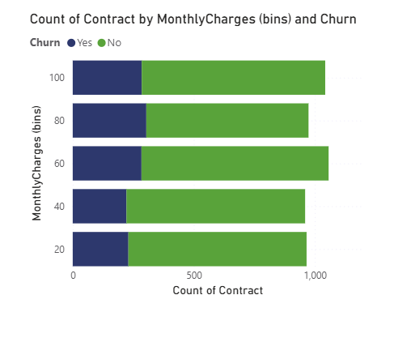
Customers with higher monthly charges churn more frequently. High pricing appears to be a major reason for churn. Reducing bill shock or offering discounts might help retain these customers.
Monthly Charges Analysis

Slide 14
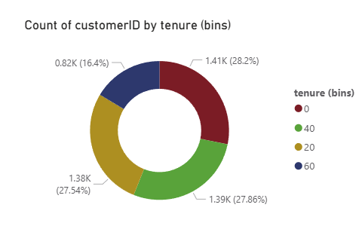
The donut chart represents the distribution of customers across different tenure groups. The tenure has been divided into bins of 20 months, allowing us to easily understand how long customers have stayed with the company.
0–20 Months: Largest segment (approx. 28%)
These customers are new and have a higher tendency to churn.
21–40 Months: Second largest group (~27.8%).
These are moderately engaged customers.
41–60 Months: (~27.5%)
Customers in this range have medium engagement and lower churn probability.
61–80 Months: Smallest group (~16%).
Long-term loyal customers who are least likely to churn.
Tenure Bins Overview

Slide 15
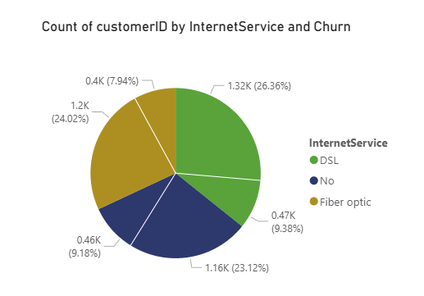
Fiber optic customers contribute the most to churn. This could be due to higher pricing or unstable service quality. DSL users show lower churn, and users without internet service churn least.
Internet Service Analysis

Slide 16
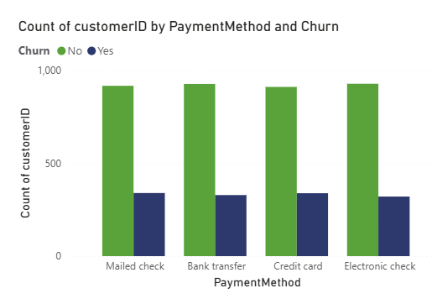
Electronic check users show the highest churn, likely because this manual payment method results in irregular billing experiences. Customers using automatic payments (credit card, bank transfer) churn less due to convenience.
Payment Method Analysis

Slide 17
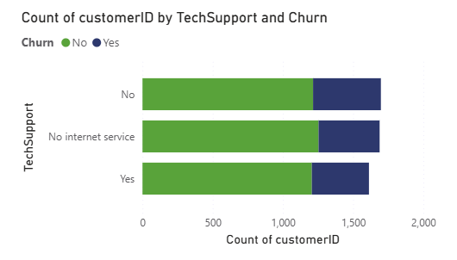
The chart shows that customers who do not use technical support have a churn rate of more than 20%, whereas customers who use technical support have a churn rate of only around 4%.
Customers without assistance face more technical issues and are more likely to leave the service.

Slide 18
Improving customer support, reducing billing issues, promoting long-term plans, and enhancing service quality can significantly reduce churn and increase customer loyalty
Use churn prediction to identify at-risk customers
Send proactive offers before they cancel
Track service complaints and resolve them faster
Recommendations

Slide 19



The analysis shows that churn is influenced by contract type, monthly charges, service quality, and support features. By addressing these issues through strategic interventions, the company can significantly reduce churn and improve retention.
SUMMARY

Slide 20
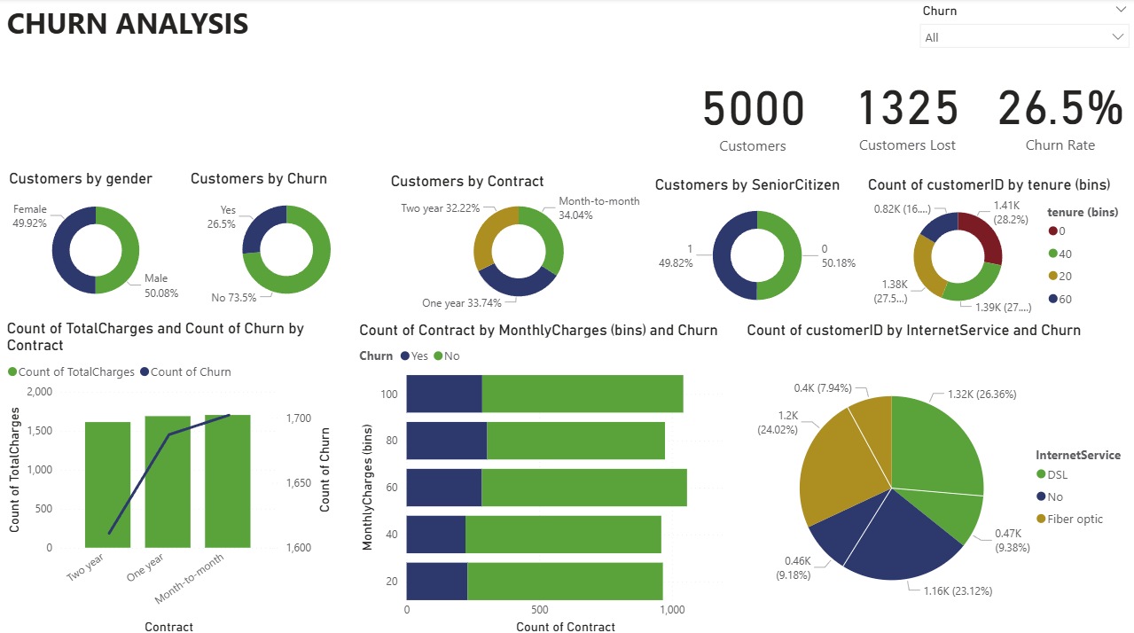
DASHBOARD PAGESVIEW

Slide 21


Email: bikashbishalmohanty@gmail.com
Contact: 9777484646

